Slide 1
WRITING SECURE CODE
Secure Login System
TEAM MEMBERS:
SAIKIRAN- 21EG109B06
SACHIN- 21EG109B19
SAITEJA- 22EG509B04

Slide 2
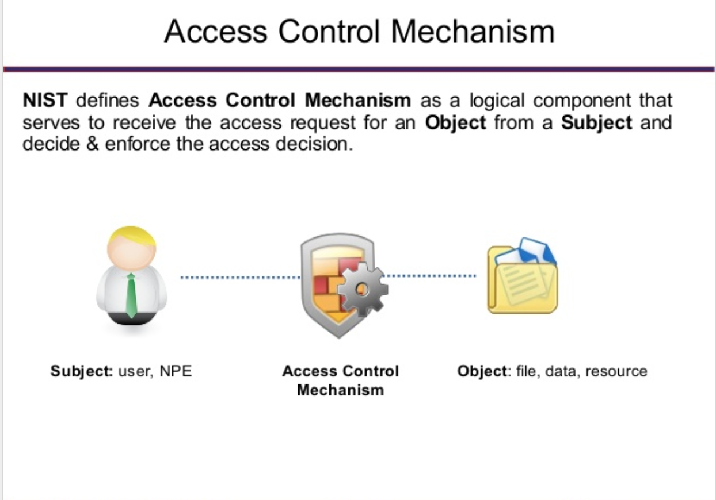
Introduction to Secure Login System
A secure login system is a mechanism that ensures only authorized individuals can access a system or application.
It protects sensitive information and prevents unauthorized access.
Secure login systems are crucial for protecting user data and maintaining the integrity of online platforms.
1
Notes:
Image source: https://cyberhoot.com/cybrary/access-control-mechanism/

Slide 3
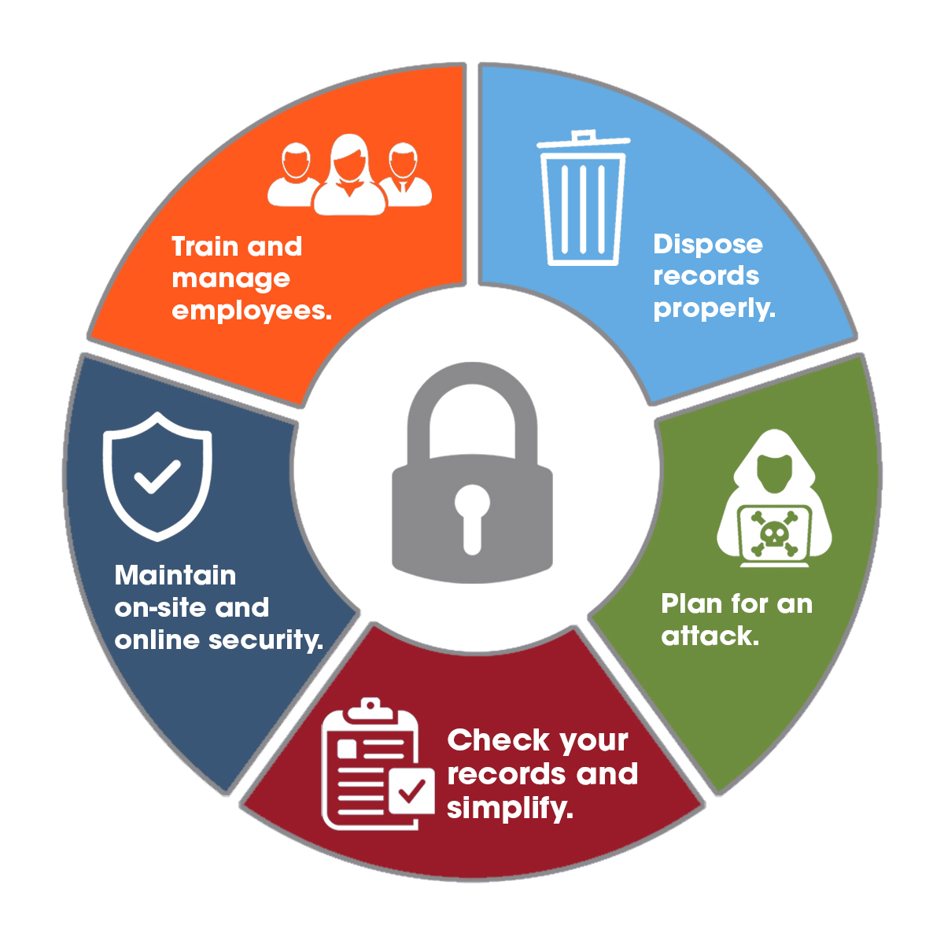
Benefits of a Secure Login System
Protection against unauthorized access and data breaches.
Safeguarding user privacy and personal information.
Enhanced trust and confidence from users.

Slide 4
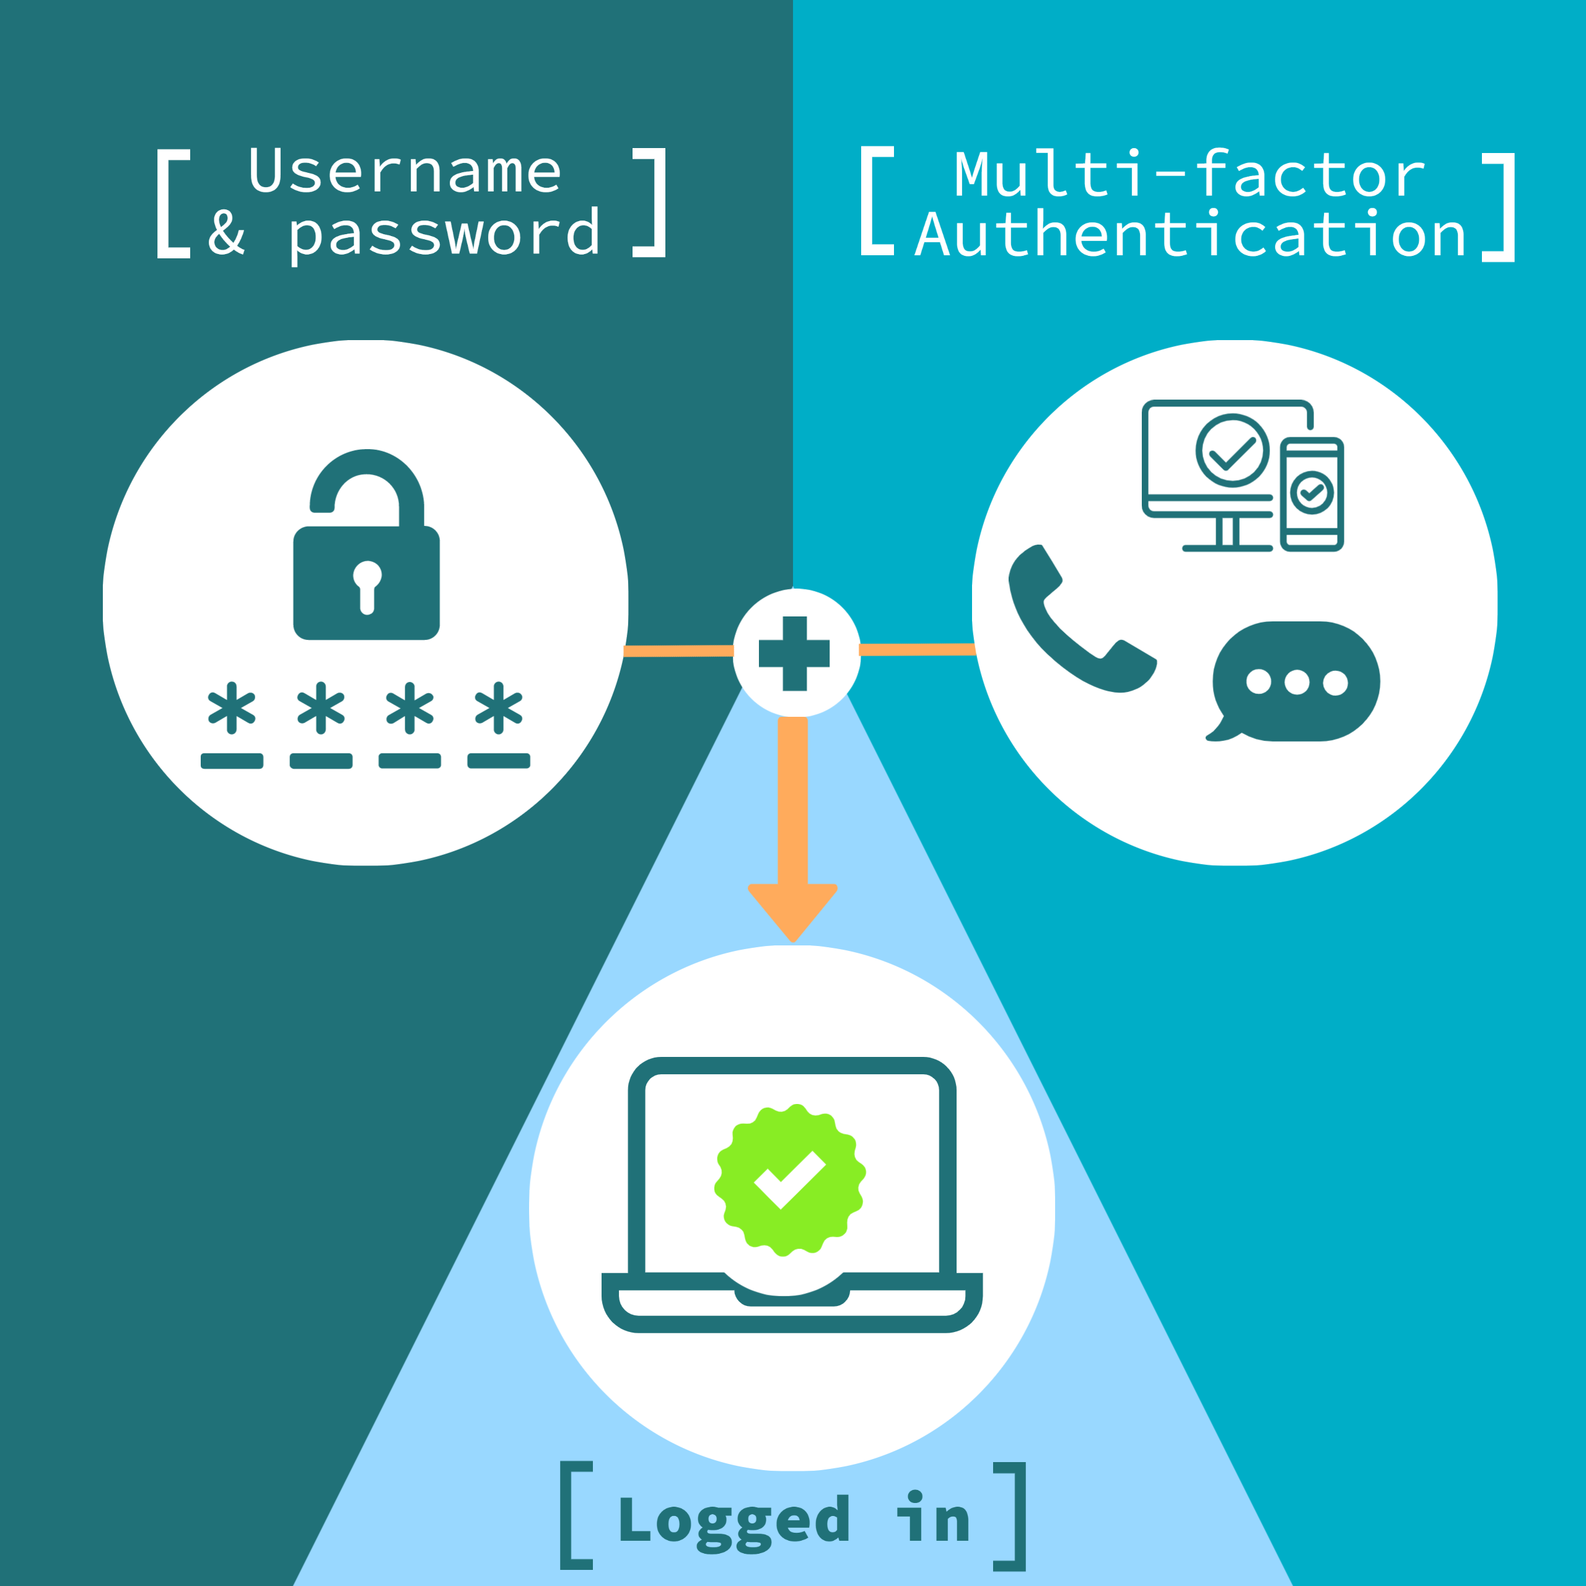
Password-based Authentication
Password-based authentication is a commonly used method for secure login systems.
Users create a unique password that they must provide to gain access.
Strong password policies, like enforcing complexity requirements and regular password updates, enhance security.
2
Notes:
Image source: https://www.bath.ac.uk/campaigns/layer-up-your-account-security-with-multi-factor-authentication-mfa/

Slide 5
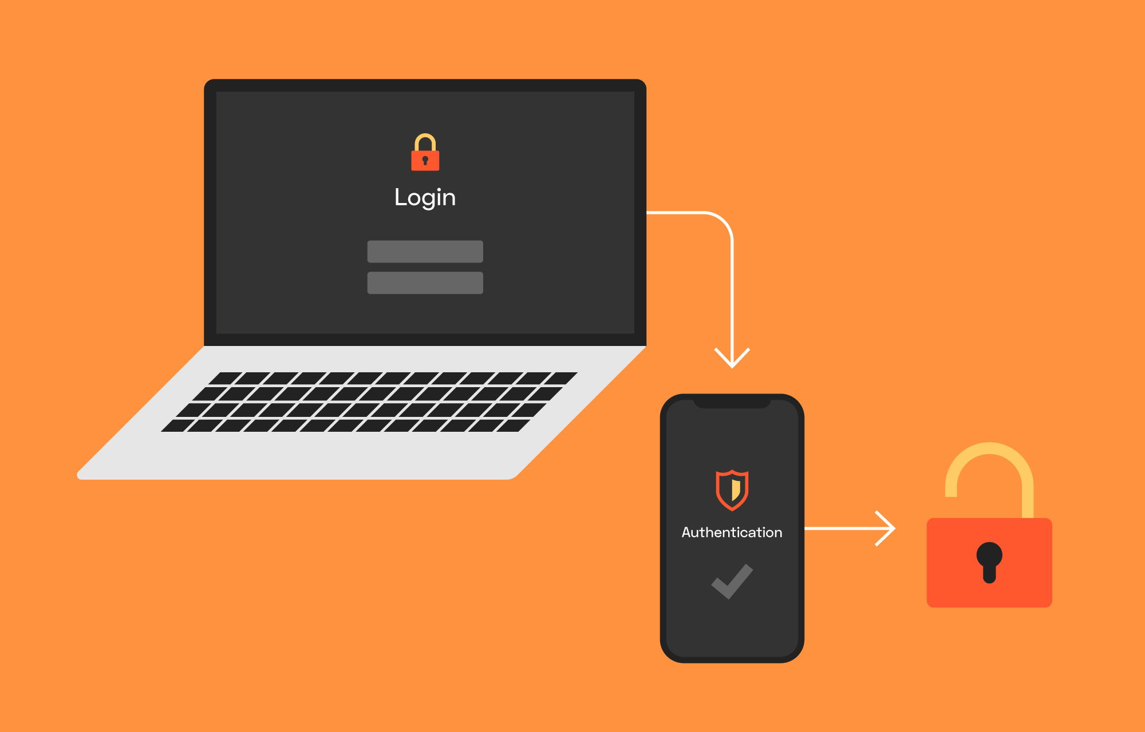
Two-Factor Authentication (2FA)
Two-factor authentication adds an extra layer of security to the login process.
It requires users to provide two different types of authentication factors, such as a password and a unique code sent to their mobile device.
2FA significantly reduces the risk of unauthorized access even if a password is compromised.

Slide 6
Multi-factor Authentication (MFA)
Multi-factor authentication adds an extra layer of security beyond passwords.
It requires users to provide multiple forms of identification, such as a password, a fingerprint, or a one-time verification code.
MFA significantly reduces the risk of unauthorized access, as it is harder for attackers to compromise multiple factors.
3
Notes:
Image source: https://www.bath.ac.uk/campaigns/layer-up-your-account-security-with-multi-factor-authentication-mfa/

Slide 7


